Slide 1
Visual Recognition
Last updated: 24-11-2024
Gonzalez R. C., Woods R. E., Eddins S. L., Digital Image Processing Using Matlab, Pearson Education, 1st edition, 2007. (Ch. 12)
Gonzalez R. C., Woods R. E., Eddins S. L., Digital Image Processing, Pearson Education, 3rd edition, 2007. (Ch. 12)
Szeliski R., Computer Vision - Algorithms and Applications, Springer, 2011. (Ch. 14)
Dr. Zulfiqar Habib, Professor
http://vig.cuilahore.edu.pk
Notes:
https://www.mathworks.com/solutions/image-video-processing/object-recognition.html

Slide 2
Common Approach
Model Generation
Models
Training
Testing
Image acquisition
Preprocessing
Segmentation
Feature extraction
Recognition
Classification Regression
Clustering
Problem domain
Knowledge base
Result

Slide 3
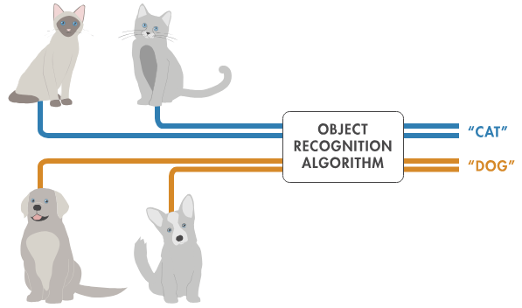

Visual Recognition
is a field of computer vision where systems are trained to identify and classify objects, patterns, or features in images or videos. It is a key technology behind applications like facial recognition, object detection, medical imaging, and autonomous vehicles. Visual recognition helps computers "see" and interpret the world like humans.

Slide 4
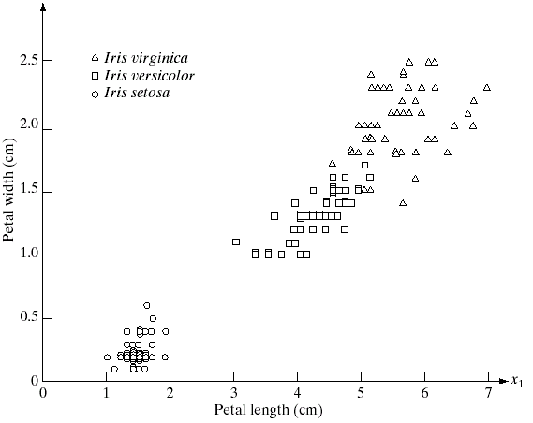
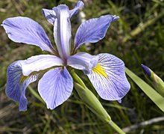
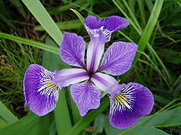
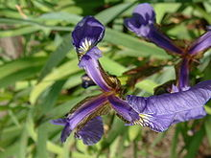
Visual Recognition
Vector Example: Iris
Pattern vectors are represented in vector form:
x = [x₁, x₂,…,x_{n}]^{T},
where x_{i}, represents the ith descriptor.
Setosa Versicolor Virginica
3 types of iris flowers described by 2 measurements

Slide 5
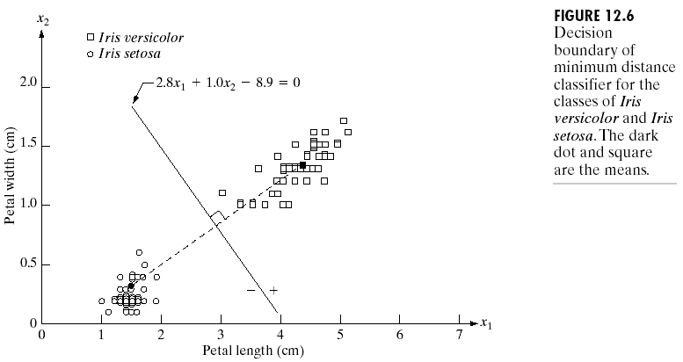
Minimum Distance Classifier

Slide 6
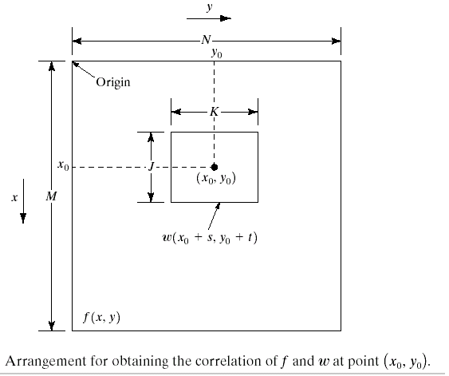
Matching by Correlation
The correlation between f(x,y) and w(x,y) is

Slide 7
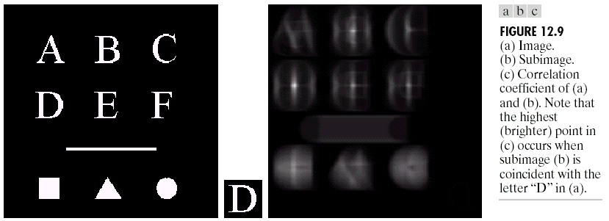
Matching by Correlation
Notes:
Correlation Range: -1 to +1
Positive Correlation: As study hours increase, exam scores tend to increase.
Negative Correlation: If more time is spent on distractions (like watching TV), exam scores may decrease.
Zero Correlation: E.g., Your weight and exam marks

Slide 8

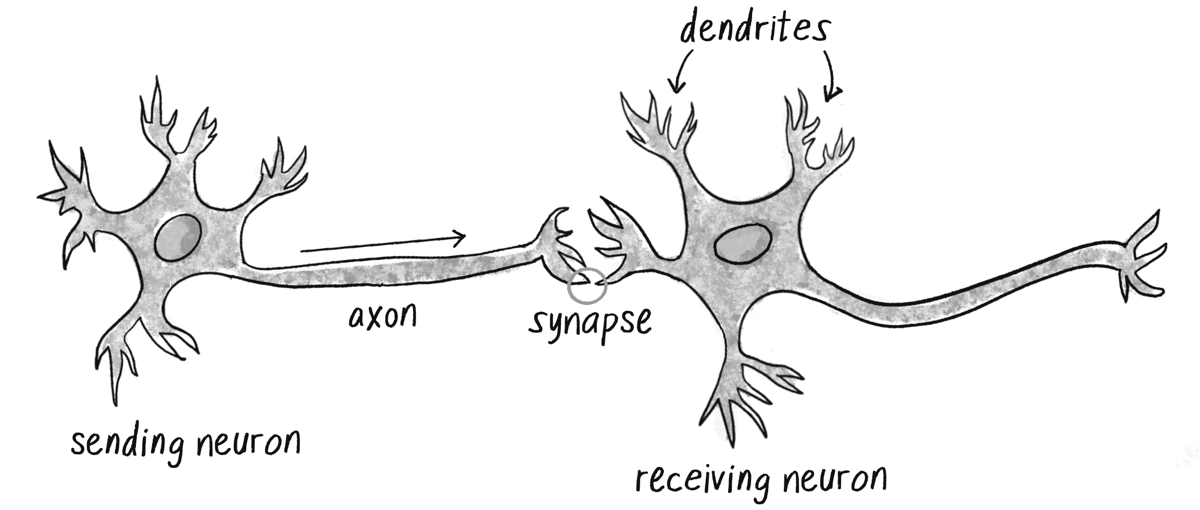
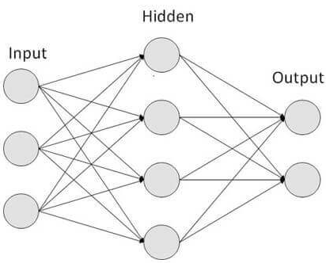
Artificial Neural Networks (ANN)
The human brain has 100 billion neurons.
Each neuron is connected to 10 thousand other neurons.
Sitting on your shoulders is the most complicated object
in the known universe. — Michio Kaku —
Notes:
https://natureofcode.com/neural-networks/

Slide 9
Artificial Neural Networks (ANN)

Slide 10
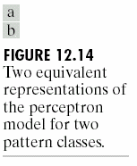
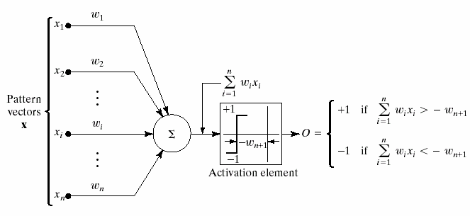
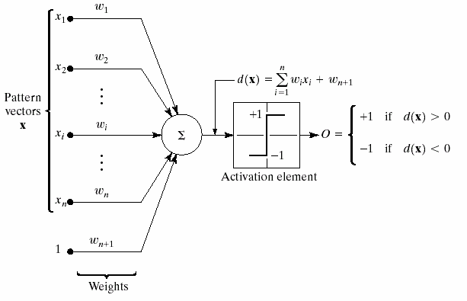
Artificial Neural Networks (ANN)
Notes:
Weights are usually between -1 and 1
Wn+1 is a bias input (will be specially useful if all vector components are zero)

Slide 11
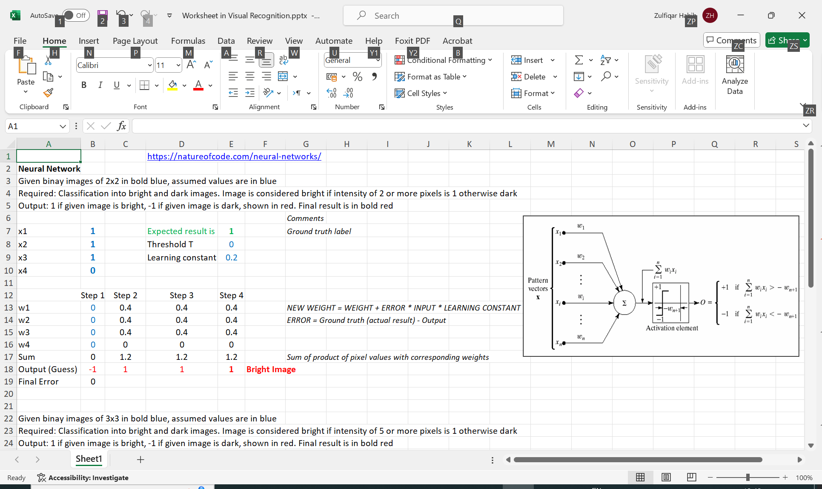
ANN – Interactive Demo
https://natureofcode.com/neural-networks
Reading

Slide 12
ANN – Extension
The class of ANN covers several architectures including Convolutional Neural Networks (CNN), Recurrent Neural Networks (RNN), e.g., Long Short-Term Memory (LSTM) and Gated Recurrent Units (GRU), Autoencoders, and Deep Belief Networks.
Therefore, CNN is just one kind of ANN and in specific has one or more layers of convolution units.

Slide 13
Examples
Basic approaches to object recognition may be sufficient depending on the application.
Image segmentation and blob analysis – which uses simple object properties, such as size, color, or shape.
Template matching – which uses a small image, or template, to find matching regions in a larger image by correlation.
Typically, if an object can be recognized using a simple approach like image segmentation, it’s best to start by using the simpler approach. This can provide a robust solution that does not require hundreds or thousands of training images or an overly complicated solution.
Notes:
https://www.mathworks.com/solutions/image-video-processing/object-recognition.html

Slide 14
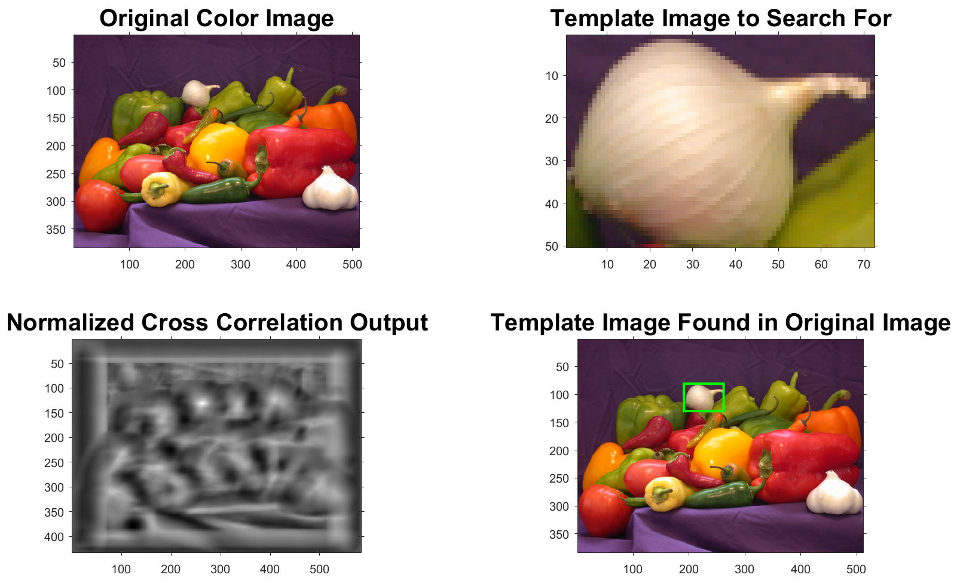
Examples
Template Based
Demo to find a template (a white onion) in a larger image of a pile of vegetables
Notes:
https://www.mathworks.com/matlabcentral/answers/79973-image-matching-with-template-in-database

Slide 15
Examples
Vegetable Detection – MATLAB Code…
clc; % Clear the command window.
close all; % Close all figures (except those of imtool.)
imtool close all; % Close all imtool figures.
clear; % Erase all existing variables.
workspace; % Make sure the workspace panel is showing.
format long g; format compact; fontSize = 20;
hasIPT = license('test', 'image_toolbox'); % Check that user has the Image Processing Toolbox installed.
if ~hasIPT % User does not have the toolbox installed.
message = sprintf('Sorry, but you do not seem to have the Image Processing Toolbox.\nDo you want to try to continue anyway?');
reply = questdlg(message, 'Toolbox missing', 'Yes', 'No', 'Yes');
if strcmpi(reply, 'No')
return;
end
end
Notes:
Vegetable_Recognition_by_Template_Matching.mlx

Slide 16
Examples
Vegetable Detection – MATLAB Code…
folder = fullfile(matlabroot, '\toolbox\images\imdemos');
baseFileName = 'peppers.png';
fullFileName = fullfile(folder, baseFileName); % Get the full filename, with path prepended.
if ~exist(fullFileName, 'file') % Didn't find it there. Check the search path for it.
fullFileName = baseFileName; % No path this time.
if ~exist(fullFileName, 'file') % Still didn't find it. Alert user.
errorMessage = sprintf('Error: %s does not exist.', fullFileName);
uiwait(warndlg(errorMessage));
return;
end
end
rgbImage = imread(fullFileName);
[rows columns numberOfColorBands] = size(rgbImage);
subplot(2, 2, 1); imshow(rgbImage, []); axis on; title('Original Color Image', 'FontSize', fontSize);
set(gcf, 'units','normalized','outerposition',[0, 0, 1, 1]); % Enlarge figure to full screen.
templateWidth = 71; templateHeight = 49; % Template by extracting a small portion of the original image.
smallSubImage = imcrop(rgbImage, [192, 82, templateWidth, templateHeight]);
subplot(2, 2, 2); imshow(smallSubImage, []); axis on; title('Template Image to Search For', 'FontSize', fontSize);

Slide 17
Examples
Vegetable Detection – MATLAB Code
channelToCorrelate = 1; % which color channel?', 'Red', 'Green', 'Blue');
correlationOutput = normxcorr2(smallSubImage(:,:,1), rgbImage(:,:, channelToCorrelate));
subplot(2, 2, 3); imshow(correlationOutput, []); axis on; title('Normalized Cross Correlation Output', 'FontSize', fontSize);
[maxCorrValue, maxIndex] = max(abs(correlationOutput(:))); % Find out brightest part in image
[yPeak, xPeak] = ind2sub(size(correlationOutput),maxIndex(1));
% Because cross correlation increases the size of the image, we need to shift back to find out where it would be in the original image.
corr_offset = [(xPeak-size(smallSubImage,2)) (yPeak-size(smallSubImage,1))];
subplot(2, 2, 4); imshow(rgbImage); axis on;
hold on; % Don't allow rectangle to blow away image.
boxRect = [corr_offset(1) corr_offset(2) templateWidth, templateHeight]; % Calculate the rectangle for the template box. Rect = [xLeft, yTop, widthInColumns, heightInRows];
rectangle('position', boxRect, 'edgecolor', 'g', 'linewidth',2); % Plot the box over the image.
title('Template Image Found in Original Image', 'FontSize', fontSize); % Give a caption above the image.
uiwait(helpdlg('Done with demo!'));

Slide 18
Examples
Vegetable Detection – Python Code…
from google.colab import drive
drive.mount('/content/drive')
import os
import cv2
import numpy as np
import matplotlib.pyplot as plt
from skimage.feature import match_template
# Load the image
image_folder_path = '/content/drive/MyDrive/Images/peppers.png'
rgb_image = cv2.imread(image_folder_path)
rgb_image = cv2.cvtColor(rgb_image, cv2.COLOR_BGR2RGB) # Convert from BGR to RGB
rows, columns, number_of_color_bands = rgb_image.shape
# Display original image
plt.figure(figsize=(15, 15))
plt.subplot(2, 2, 1)
plt.imshow(rgb_image)
plt.title("Original Color Image")
plt.axis("on")
Notes:
Vegetable_Recognition_by_Template_Matching.ipynb

Slide 19
Examples
Vegetable Detection – Python Code…
# Extract a template (small portion of the image)
template_width, template_height = 71, 49
template = rgb_image[82:82 + template_height, 192:192 + template_width]
plt.subplot(2, 2, 2)
plt.imshow(template)
plt.title("Template Image to Search For")
plt.axis("on")
# Perform normalized cross-correlation
correlation_output = match_template(rgb_image[:, :, 0], template[:, :, 0])
# Display correlation output
plt.subplot(2, 2, 3)
plt.imshow(correlation_output, cmap="gray")
plt.title("Normalized Cross Correlation Output")
plt.axis("on")
# Find the peak correlation position
max_corr_value = np.max(correlation_output)
y_peak, x_peak = np.unravel_index(np.argmax(correlation_output), correlation_output.shape)

Slide 20
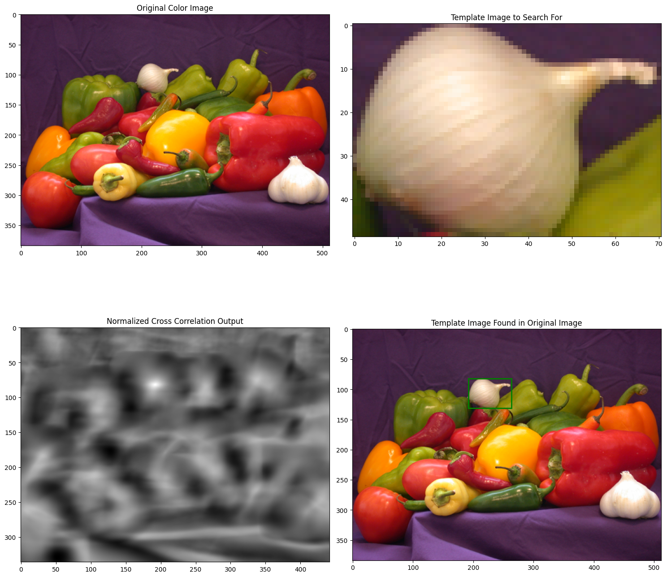
Examples
Vegetable Detection – Python Code
# Compute rectangle coordinates in the original image
corr_offset = (x_peak, y_peak)
box_rect = [corr_offset[0], corr_offset[1], template_width, template_height]
# Display the template match on the original image
plt.subplot(2, 2, 4)
plt.imshow(rgb_image)
plt.title("Template Image Found in Original Image")
plt.axis("on")
plt.gca().add_patch(
plt.Rectangle(
(box_rect[0], box_rect[1]),
box_rect[2],
box_rect[3],
edgecolor="g",
linewidth=2,
fill=False,
)
)
plt.tight_layout()
plt.show()
print("Done with demo!")

Slide 21
Examples
Template Based - Automatic Number Plate Recognition (ANPR)
Matching by Correlation
For
OCR (Optical Character Recognition)
(simple cases only)
Notes:
http://ashokbasnet.com.np/2010/04/anprautomatic-number-plate-recognition-using-alrautomatic-line-tracking-robot/

Slide 22
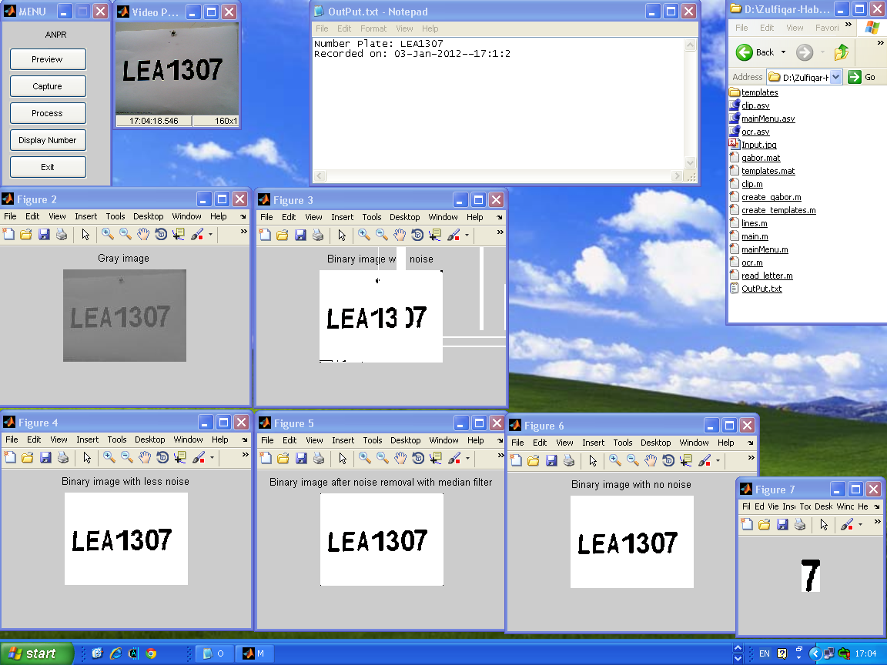

Slide 23
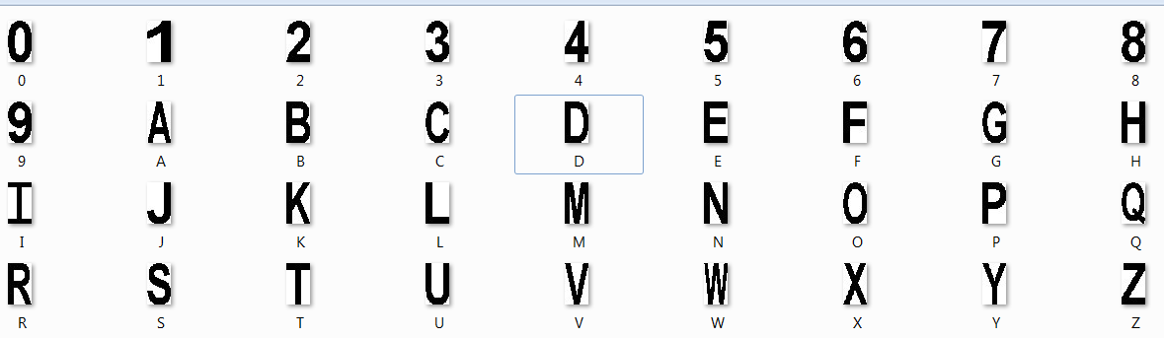
Examples
ANPR: Folder “templates”
Collection of templates, binary images of all possible characters normalized at the same size, say 42x24.

Slide 24
Examples
ANPR: mainMenu.m
clc; clear; close all;
if ~exist('templates.mat','file') % if not exist templates.mat file
fprintf ('Creating templates.mat file ...');
create_templates; % create_templates.m
end
vid = videoinput('winvideo',1);
while (true)
a=menu('Automatic Number Plate Recognition (ANPR)',...
'Preview',...
'Capture',...
'Process',...
'Display Number',...
'Exit');
if (a == 1)
preview(vid);
end
Nested Files
mainMenu.m
create_templates.m
ocr.m
lines.m
clip.m
read_letter.m

Slide 25
Examples
ANPR: mainMenu.m
if(a == 2)
testpic = getsnapshot(vid);
imwrite(testpic,'Input.jpg');
imshow(testpic);
end
if (a == 3)
img = imread('Input.jpg');
%img = imread('Good-image.jpg'); % pre-recorded image for testing only
ocr; % ocr.m
end
if (a == 4)
winopen('Output.txt'); % Output in the text file
end
if (a == 5)
delete(vid); close all;
return;
end
end % while

Slide 26
Examples
ANPR: create_templates.m
% CREATE templates.mat file
% Letter
A=imread('templates\A.bmp'); B=imread('templates\B.bmp');
C=imread('templates\C.bmp'); D=imread('templates\D.bmp');
E=imread('templates\E.bmp'); F=imread('templates\F.bmp');
G=imread('templates\G.bmp'); H=imread('templates\H.bmp');
I=imread('templates\I.bmp'); J=imread('templates\J.bmp');
K=imread('templates\K.bmp'); L=imread('templates\L.bmp');
M=imread('templates\M.bmp'); N=imread('templates\N.bmp');
O=imread('templates\O.bmp'); P=imread('templates\P.bmp');
Q=imread('templates\Q.bmp'); R=imread('templates\R.bmp');
S=imread('templates\S.bmp'); T=imread('templates\T.bmp');
U=imread('templates\U.bmp'); V=imread('templates\V.bmp');
W=imread('templates\W.bmp'); X=imread('templates\X.bmp');
Y=imread('templates\Y.bmp'); Z=imread('templates\Z.bmp');

Slide 27
Examples
ANPR: create_templates.m
% Number
one=imread('templates\1.bmp'); two=imread('templates\2.bmp');
three=imread('templates\3.bmp'); four=imread('templates\4.bmp');
five=imread('templates\5.bmp'); six=imread('templates\6.bmp');
seven=imread('templates\7.bmp'); eight=imread('templates\8.bmp');
nine=imread('templates\9.bmp'); zero=imread('templates\0.bmp');
%*-*-*-*-*-*-*-*-*-*-*-
letter=[A B C D E F G H I J K L M...
N O P Q R S T U V W X Y Z];
number=[one two three four five...
six seven eight nine zero];
character=[letter number];
templates=mat2cell(character,42,[24 24 24 24 24 24 24 ...
24 24 24 24 24 24 24 ...
24 24 24 24 24 24 24 ...
24 24 24 24 24 24 24 ...
24 24 24 24 24 24 24 24]);
save ('templates', 'templates') % to save as templates.mat file

Slide 28
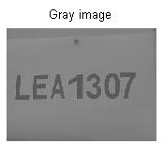
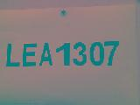
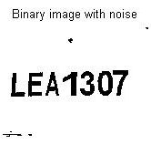
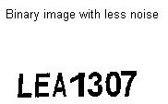
Examples
ANPR: ocr.m
warning off
img = rgb2gray(img);
imshow(img); title('Gray image'), pause(2), figure
level = graythresh(img);
imagen = im2bw(img, level);
imshow(imagen); title('Binary image with noise'), pause(2), figure
imagen = ~imagen;
imagen = bwareaopen(imagen,70); % remove small objects above 70 pixels
imagen = ~imagen;
imshow(imagen);
title('Binary image with less noise'), pause(2), figure

Slide 29
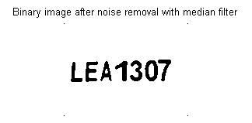

Examples
ANPR: ocr.m
imagen = medfilt2(imagen);
imshow(imagen);
title('Binary image after noise removal with median filter'), pause(2), figure
% to remove black dots at corners of image
[r c]=size(imagen);
imagen(1,1)=255; imagen(r,1)=255;
imagen(1,c)=255; imagen(r,c)=255;
imshow(imagen);
title('Binary image with no noise'), pause(2), figure
word=[]; %Storage matrix word from image
re=imagen;
fid = fopen('Output.txt', 'at'); % Opens Output.txt as file for write

Slide 30
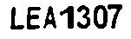
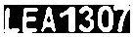
Examples
ANPR: ocr.m
while true
[fl re]=lines(re); % lines.m, separate lines in text
imgn=~fl;
% Calculating connected components
L = bwlabel(imgn); % 7 components are labeled
mx = max(max(L)); % mx = 7
BW = edge(double(imgn), 'sobel');
[imx, imy] = size(BW); % imx = 29, imy = 129

Slide 31


Examples
ANPR: ocr.m
for n=1:mx
[r,c] = find(L==n);
rc = [r c]; % Locations of all pixels of nth component
[sx sy]=size(rc); % for n = 1: sx = 161 rows, sy = 2 cols
n1=zeros(imx, imy);
for i=1:sx
x1=rc(i,1);
y1=rc(i,2);
n1(x1,y1)=255;
end

Slide 32
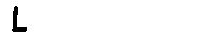
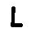
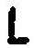
Examples
ANPR: ocr.m
n1 = ~n1;
n1 = ~clip(n1); % clip.m, image cropping
% conversion equal to the size in create_templates.m file
img_r = imresize(n1, [42 24]);
letter = read_letter(img_r); % read_letter.m, img to text
word=[word letter];
end % for

Slide 33
Examples
ANPR: ocr.m
% Write 'word' in text file with date & time
zClock=uint16(clock);
zDate=strcat(date,'--', int2str(zClock(4)),':', int2str(zClock(5)), ':', int2str(zClock(6)));
fprintf(fid,'Number Plate: %s\nRecorded on: %s\n\n',word,zDate); %Write 'word' in text file
if isempty(re) %See variable 're' in Fcn 'lines'
break
end
end % while
fclose(fid);

Slide 34
Examples
ANPR: lines.m
function [fl re]=lines(aa) % Divide text in lines, used by ocr.m
aa=clip(aa); % clip.m
r=size(aa,1);
for s=1:r
if sum(aa(s,:))==0
nm=aa(1:s-1,1:end);%First line matrix
rm=aa(s:end,1:end);%Remain line matrix
fl=~clip(~nm);
re=~clip(~rm);
break
else
fl=~aa;%Only one line.
re=[];
end
end

Slide 35
Examples
ANPR: clip.m
function imgn=clip(imagen) % used by ocr.m and lines.m
% Crops a black letter with white background.
if ~islogical(imagen)
imagen=im2bw(imagen,0.99);
end
a=~imagen;
[f c]=find(a);
lmaxc=max(c); lminc=min(c);
lmaxf=max(f); lminf=min(f);
imgn=a(lminf:lmaxf,lminc:lmaxc); % Crops image

Slide 36
Examples
ANPR: read_letter.m
function letter=read_letter(imagn) % for use in ocr.m
% Computes the correlation between template and input image and its output is a string containing the letter.
% Size of 'imagn' must be 42 x 24 pixels
comp=[];
load templates % created by create_templates.m and generated file templates.mat
for n=1:36
sem=corr2(templates{1,n},imagn); % range -1 to 1, 1 is perfect
comp=[comp sem];
end
vd=find(comp==max(comp));

Slide 37
Examples
ANPR: read_letter.m
if vd==1
letter='A';
elseif vd==2
letter='B';
elseif vd==3
letter='C';
elseif vd==4
letter='D';
elseif vd==5
letter='E';
elseif vd==6
letter='F';
elseif vd==7
letter='G';
elseif vd==8
letter='H';
elseif vd==9
letter='I';
elseif vd==10
letter='J';
elseif vd==11
letter='K';
elseif vd==12
letter='L';
elseif vd==13
letter='M';
elseif vd==14
letter='N';
elseif vd==15
letter='O';
elseif vd==16
letter='P';
elseif vd==17
letter='Q';
elseif vd==18
letter='R';
elseif vd==19
letter='S';
elseif vd==20
letter='T';
elseif vd==21
letter='U';
elseif vd==22
letter='V';
elseif vd==23
letter='W';
elseif vd==24
letter='X';
elseif vd==25
letter='Y';
elseif vd==26
letter='Z';
elseif vd==27
letter='1';
elseif vd==28
letter='2';
elseif vd==29
letter='3';
elseif vd==30
letter='4';
elseif vd==31
letter='5';
elseif vd==32
letter='6';
elseif vd==33
letter='7';
elseif vd==34
letter='8';
elseif vd==35
letter='9';
else
letter='0';
end

Slide 38
Exercise
Write a code to read a license plate in real-time and convert it into text.

Slide 39
Examples
Feature Based
Computer Vision System Toolbox™ provides pre-trained object detectors and the functionality to train a custom detector.
The cascade object detector uses the Viola-Jones algorithm to detect people's faces, noses, eyes, mouth, or upper body.
It is widely used method for real-time object detection. Training is slow, but detection is very fast.
Viola-Jones algorithm detects people in an input image using the histogram of oriented gradients (HOG) features and a trained support vector machine (SVM) classifier.

Slide 40
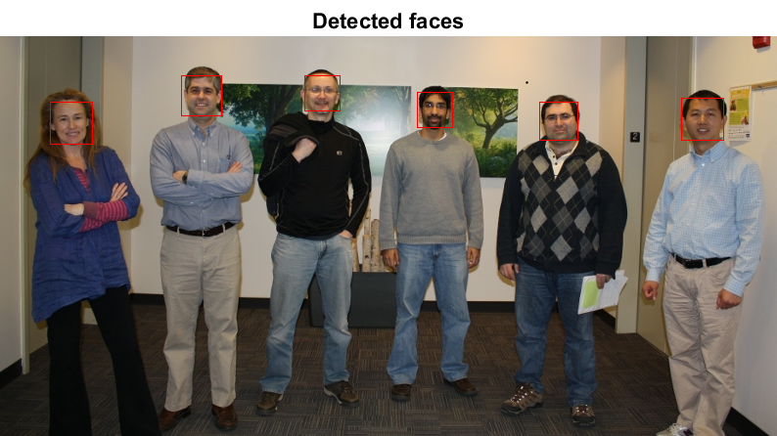
Examples
Face Detection – MATLAB Code
% Create a detector object
faceDetector = vision.CascadeObjectDetector; % Using Viola-Jones algorithm, Default: finds faces
MyImage = imread('visionteam.jpg');
bbox = step(faceDetector, MyImage); % Detect faces
% Draw bounding boxes
shapeInserter = vision.ShapeInserter('BorderColor', 'Custom', 'CustomBorderColor', [255 0 0]);
My_faces = step(shapeInserter, MyImage, int32(bbox));
imshow(My_faces), title('Detected faces');
Notes:
Face_Detection_Using_Features.mlx

Slide 41
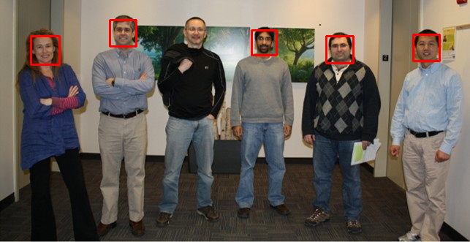
Examples
Face Detection – Python Code
from google.colab import drive
drive.mount('/content/drive')
import cv2
from google.colab.patches import cv2_imshow # For displaying images in Colab
# Load the image
image = cv2.imread('/content/drive/MyDrive/Images/visionteam.jpg’) # Using Viola-Jones algorithm
# Create a face detector using Haar cascades (default OpenCV face detector)
face_cascade = cv2.CascadeClassifier(cv2.data.haarcascades + 'haarcascade_frontalface_default.xml')
# Convert the image to grayscale (required for face detection)
gray_image = cv2.cvtColor(image, cv2.COLOR_BGR2GRAY)
# Detect faces in the image
faces = face_cascade.detectMultiScale(gray_image, scaleFactor=1.1, minNeighbors=5, minSize=(30, 30))
# Draw bounding boxes around detected faces
for (x, y, w, h) in faces:
cv2.rectangle(image, (x, y), (x + w, y + h), (0, 0, 255), 2) # Blue bounding box
# Display the image with bounding boxes
cv2_imshow(image)
cv2.waitKey(0) # Wait for key press to close the image window
cv2.destroyAllWindows()
No Detection
Notes:
Face_Detection_Using_Features.ipynb

Slide 42

Examples
Face Detection – Python Code
from google.colab import drive
drive.mount('/content/drive')
import cv2
from google.colab.patches import cv2_imshow # For displaying images in Colab
# Load the image
image = cv2.imread('/content/drive/MyDrive/Images/visionteam.jpg')
# Create a face detector using Haar cascades (default OpenCV face detector)
face_cascade = cv2.CascadeClassifier(cv2.data.haarcascades + 'haarcascade_frontalface_default.xml')
# Convert the image to grayscale (required for face detection)
gray_image = cv2.cvtColor(image, cv2.COLOR_BGR2GRAY)
# Detect faces in the image
faces = face_cascade.detectMultiScale(gray_image, scaleFactor=1.1, minNeighbors=5, minSize=(30, 30))
# Draw bounding boxes around detected faces
for (x, y, w, h) in faces:
cv2.rectangle(image, (x, y), (x + w, y + h), (0, 0, 255), 2) # Blue bounding box
# Display the image with bounding boxes
cv2_imshow(image)
cv2.waitKey(0) # Wait for key press to close the image window
cv2.destroyAllWindows()
# Histogram equalization gray_image = cv2.equalizeHist(gray_image)
Notes:
Face_Detection_Using_Features.ipynb

Slide 43
Object Recognition Using Transfer Learning: MATLAB
% A simple example of transfer learning using AlexNet
clc; clear; close all;
net = alexnet; % Access the pretrained model
I = imread('FruitA2.jpg');
sz = net.Layers(1).InputSize; % Find size of the image
J = imresize(I,[sz(1) sz(2)]); % Adjust size of the image
label = classify(net, J); % Classify the image using AlexNet
% Show the image and the classification results
figure
imshow(I)
text(10,20,char(label),'Color', 'red')
Notes:
Classification_using_AlexNet_Simple_Example.m

Slide 44
Object Recognition Using Transfer Learning: Python…
from google.colab import drive
drive.mount('/content/drive')
import tensorflow as tf
from tensorflow.keras.applications import imagenet_utils
from tensorflow.keras.preprocessing import image
import matplotlib.pyplot as plt
import numpy as np
from PIL import Image
from google.colab.patches import cv2_imshow # For displaying images in Colab
# Load the AlexNet-equivalent model (VGG16 is used as AlexNet is not directly available in Keras)
model = tf.keras.applications.VGG16(weights="imagenet") # Pretrained model similar to AlexNet
# Load the image
I = Image.open('/content/drive/MyDrive/Images/FruitA2.jpg')
# Resize the image to the model's input size (224x224 for AlexNet and VGG16)
sz = (224, 224) # AlexNet and VGG16 standard input size
J = I.resize(sz)
Notes:
Classification_using_Transfer_Learning.ipynb

Slide 45
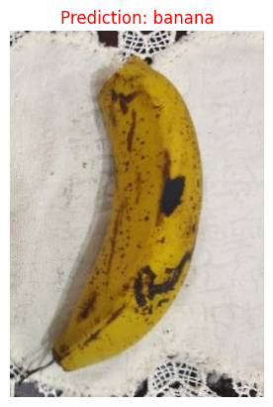
Object Recognition Using Transfer Learning: Python
# Preprocess the image for AlexNet/VGG16
img_array = image.img_to_array(J) # Convert to numpy array
img_array = np.expand_dims(img_array, axis=0) # Add batch dimension
img_array = tf.keras.applications.vgg16.preprocess_input(img_array) # Preprocess the image
# Classify the image
predictions = model.predict(img_array)
label = imagenet_utils.decode_predictions(predictions, top=1)[0][0][1] # Get the top prediction label
# Display the image and classification result
plt.figure()
plt.imshow(I)
plt.title(f"Prediction: {label}", color="red")
plt.axis('off')
plt.show()

Slide 46
Live Object Recognition Using Transfer Learning
clc; clear; close all;
camera = webcam;
net = alexnet; % Load the pretrained neural network
for idx = 1:100
im = snapshot(camera); % Take a picture
image(im); % Show the picture
im = imresize(im,[227 227]); % Resize the picture for alexnet
label = classify(net,im); % Classify the picture
title(char(label)); % Show the class label
drawnow
end
clear;
Notes:
Live_Classification_using_AlexNet.m

Slide 47
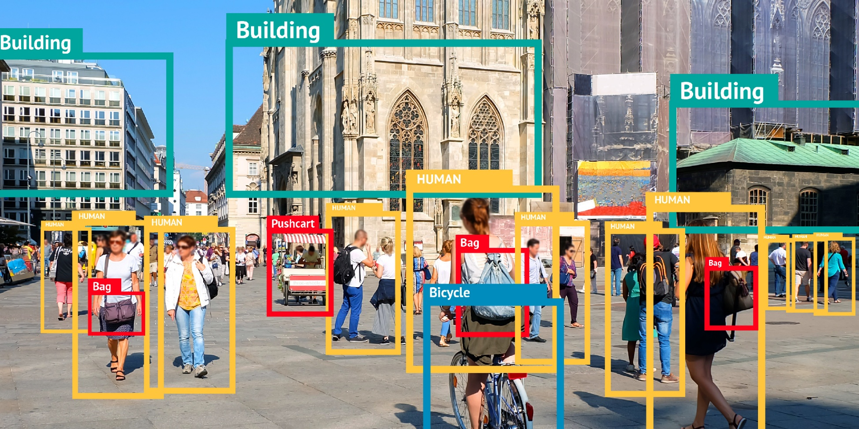
YOLO - You Only Look Once
YOLO is very efficient real-time single regression object detection model.
Identifies objects in images/videos in a single pass.
Ideal for detecting vehicles, pedestrians, and traffic.
It was first described in 2016 by Joseph Redmon, Santosh Divvala, Ross Girshick and Ali Farhadi
Notes:
https://youtu.be/3bo8S1pAbqk?si=i-nBaIL9iC-lXLrt
https://cocodataset.org/
COCO is a large-scale object detection, segmentation, and captioning dataset. COCO has several features:
Object segmentation
Recognition in context
Superpixel stuff segmentation
330K images (>200K labeled)
1.5 million object instances
80 object categories
91 stuff categories
5 captions per image
250,000 people with keypoints
https://encord.com/blog/yolo-object-detection-guide/

Slide 48
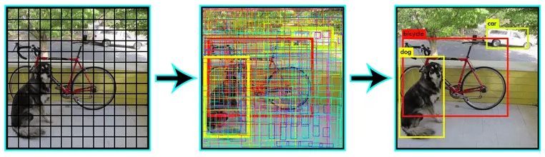
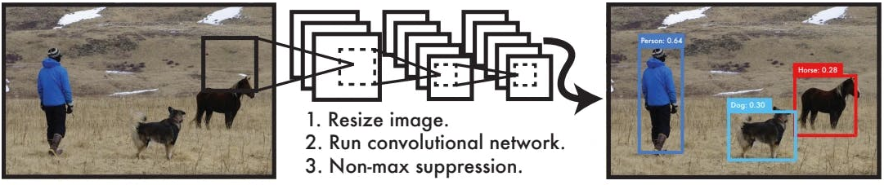
YOLO – How It Works?
Divides the image into grids.
Each grid predicts:
Object class (e.g., car, bus).
Object location (bounding box).
Confidence score.
Fast and efficient for real-time applications.

Slide 49
YOLO – Use Case: Road Traffic Tracking
Detect and track:
Cars, buses, motorcycles.
Traffic density and flow.
Applications:
Traffic management.
Accident detection.
Smart cities.

Slide 50
YOLO – Use Case: Road Traffic Tracking

Slide 51
Comparison of Visual Recognition Algorithms
Algorithm | Best For | Speed | Accuracy | Complexity
Viola-Jones | Face detection | Very Fast | Moderate | Low
CNNs | General image tasks | Moderate | High | High
R-CNN/Faster R-CNN | Object detection | Moderate | Very High | Very High
YOLO | Real-time detection | Very Fast | High | Moderate
SVM | Simple classification | Slow | High (binary tasks) | Moderate
Vision Transformers | Large datasets | Moderate | Very High | Very High
KNN | Simple classification | Slow | Moderate | Low
Notes:
1. Viola-Jones Algorithm
Purpose: Detects faces or objects in an image.
How it Works:
Uses Haar-like features to identify objects.
Works with a sliding window and integral image for efficiency.
Applies a cascade classifier to discard non-object areas quickly.
Advantages:
Fast and simple.
Suitable for real-time applications like webcams.
Use Case: Face detection in real-time systems.
2. Convolutional Neural Networks (CNNs)
Purpose: Recognizes and classifies objects in images.
How it Works:
Extracts features using convolutional layers.
Uses pooling layers to reduce image size.
Fully connected layers make predictions based on extracted features.
Popular Architectures:
AlexNet: Early breakthrough model in deep learning.
VGGNet: Known for simplicity and depth (16-19 layers).
ResNet: Introduced skip connections to avoid vanishing gradients in deep networks.
Advantages:
Highly accurate.
Can handle complex images.
Use Case: Classifying objects like cats, dogs, and more.
3. Region-based CNNs (R-CNN)
Purpose: Detects objects and their bounding boxes in an image.
How it Works:
Divides the image into regions of interest.
Applies CNN to each region for classification and localization.
Variants:
Fast R-CNN: Speeds up by sharing features between regions.
Faster R-CNN: Adds a Region Proposal Network (RPN) for better efficiency.
Advantages:
High precision for object detection.
Use Case: Object detection in autonomous vehicles or surveillance.
4. YOLO (You Only Look Once)
Purpose: Real-time object detection.
How it Works:
Divides the image into a grid.
Each grid predicts bounding boxes and object classes simultaneously.
Advantages:
Very fast and efficient.
Can handle multiple objects in a single pass.
Use Case: Detecting pedestrians or vehicles in real-time.
5. Support Vector Machines (SVM)
Purpose: Classifies objects using features extracted from images.
How it Works:
Finds a hyperplane to separate classes in a high-dimensional space.
Often combined with feature extraction techniques like HOG (Histogram of Oriented Gradients).
Advantages:
Effective for binary classification problems.
Use Case: Classifying handwritten digits or identifying faces.
6. Transformers in Vision (e.g., ViT - Vision Transformers)
Purpose: Processes images using self-attention mechanisms (like in NLP).
How it Works:
Splits the image into patches.
Processes patches using attention mechanisms to learn relationships between image parts.
Advantages:
Excellent performance on large datasets.
Captures long-range dependencies in images.
Use Case: High-performance image classification tasks.
7. K-Nearest Neighbors (KNN)
Purpose: Simple algorithm for image classification.
How it Works:
Compares the input image with stored images in the dataset.
Classifies based on the majority class of the k-nearest neighbors.
Advantages:
Simple and easy to implement.
Use Case: Basic visual recognition tasks, such as classifying simple objects.

Slide 52
Exercise
Write a code for live object recognition and return confidence level in %age and object name (text and voice) by using a pre-trained deep learning model (e.g., transfer learning).

Slide 53
Extra Stuff

Slide 54
Patterns and Pattern Classes
A pattern is an arrangement of descriptors.
Feature is used to denote a descriptor.
A pattern class is a family of patterns that share a set of common properties, denoted by
ω_{i}, i=1,2,…,W, where W is the number of classes.
Pattern recognition: to assign patterns to their respective classes.
Recognition Types:
Structural
Decision Theoretic (quantitative)

Slide 55
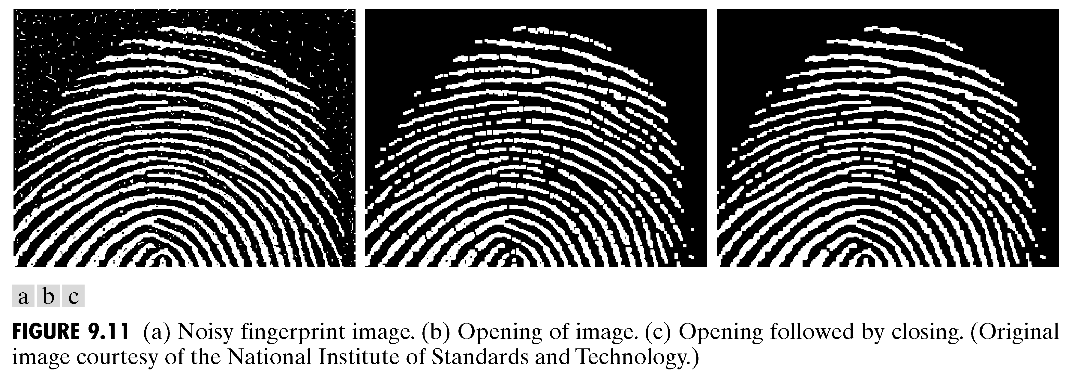
Pattern Recognition
Structural Recognition: Based on representing objects of interest as strings, trees, or graphs.
E.g., fingerprint recognition is based on the interrelationships of print features called minutiae. Together with their relative sizes and locations, these features are primitive components that describe finger-print ridge properties such as abrupt endings, branching, merging, and disconnected segments.

Slide 56
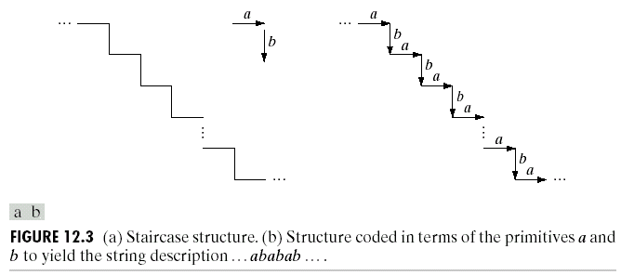
Pattern Recognition
String descriptions adequately generate patterns of objects and other entities whose structure is based on relatively simple connectivity of primitives, usually associated with boundary shape.

Slide 57
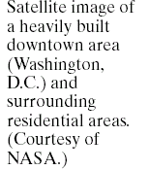
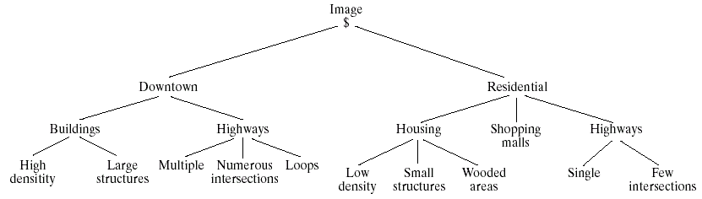
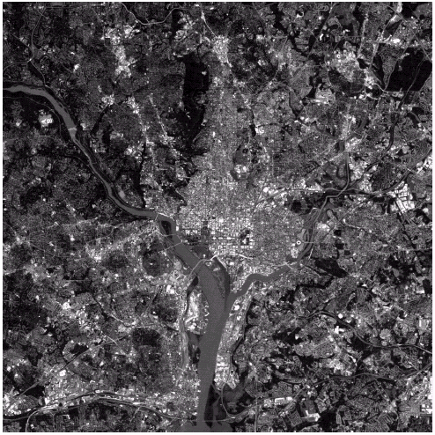
Pattern Recognition
Tree descriptions is more powerful than string ones.
Most hierarchical ordering schemes lead to tree structure.
A tree description of the image:

Slide 58
Pattern Recognition
Decision Theoretic Recognition: It is based on the use of decision functions and vector pattern arrangement is used. Common classifiers are:
Minimum-Distance Classifier
Correlation Based Classifier
Optimum Statistical Classifier
Bayes
Support Vector Machine (SVM)
Neural Networks

Slide 59
Decision-Theoretic Methods
Let x = [x₁, x₂,…,x_{n}]^{T} represent an n-dimensional pattern vector.
For W pattern classes ω_{i}, i = 1,2,…,W, we want to find W decision functions d₁(x), d₂(x),…, d_{w}(x), with the property that, if a pattern x belongs to class ω_{i} , then
d_{i}(x) > d_{j}(x), j = 1,2,…,W; i ≠ j
The decision boundary separating class ω_{i} from ω_{j} is given by values of x for which
d_{i}(x) = d_{j}(x) or d_{i}(x) - d_{j}(x) = 0.

Slide 60
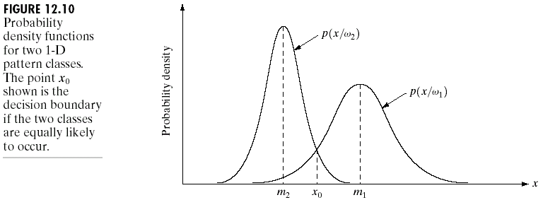
Decision-Theoretic Methods
Optimum Statistical Classifiers
Bayes classifier for Gaussian pattern classes

Slide 61
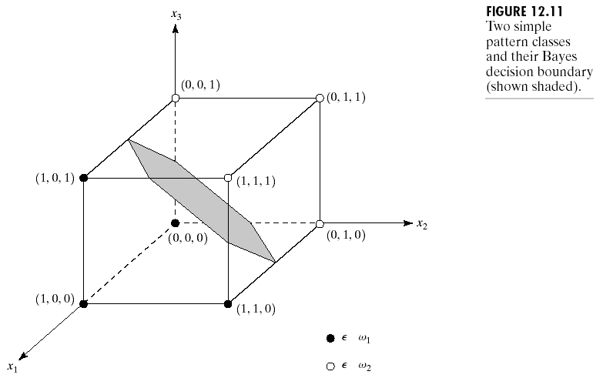
Decision-Theoretic Methods
Optimum Statistical Classifiers

Slide 62
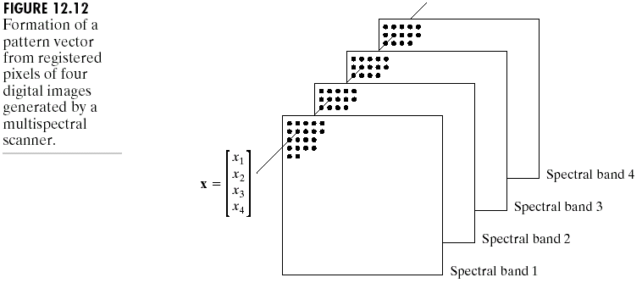
Decision-Theoretic Methods
Optimum Statistical Classifiers
Classification of multi-spectral data using the Bayes classifier

